Slide 1
2
Psalm 23

Slide 2
“Even though I walk through the valley of the shadow of death, I will fear no evil, for you are with me; your rod and your staff, they comfort me.” - Psalm 23:4
“Valley of the shadow of death” – The valleys of life disappointment, serious illness, loneliness, age and death
Psalm 27:1 – “The Lord is my light and my salvation; whom shall I fear? The Lord is the stronghold of my life; of whom shall I be afraid?”
2 Corinthians 4:8-10 – We are afflicted in every way, but not crushed; perplexed, but not driven to despair; persecuted, but not forsaken; struck down, but not destroyed; always carrying in the body the death of Jesus, so that the life of Jesus may also be manifested in our bodies.

Slide 3
“Even though I walk through the valley of the shadow of death, I will fear no evil, for you are with me; your rod and your staff, they comfort me.” - Psalm 23:4
“I will fear no evil”
Isaiah 41:10 – “Fear not, for I am with you; be not dismayed, for I am your God; I will strengthen you, I will help you, I will uphold you with my righteous right hand.”
Psalm 118:6 – “The Lord is on my side; I will not fear. What can man do to me?”

Slide 4
“Even though I walk through the valley of the shadow of death, I will fear no evil, for you are with me; your rod and your staff, they comfort me.” - Psalm 23:4
“For you are with me”
Hebrews 13:5-6 – Keep your life free from love of money, and be content with what you have, for he has said, "I will never leave you nor forsake you." So we can confidently say, "The Lord is my helper; I will not fear; what can man do to me?"

Slide 5
“Even though I walk through the valley of the shadow of death, I will fear no evil, for you are with me; your rod and your staff, they comfort me.” - Psalm 23:4
“Your rod and your staff, they comfort me” – Speaks of divine protection
1 Corinthians 10:13 – No temptation has overtaken you that is not common to man. God is faithful, and he will not let you be tempted beyond your ability, but with the temptation he will also provide the way of escape, that you may be able to endure it.”
2 Peter 2:8-9 – “Then the Lord knows how to rescue the godly from trials, and to keep the unrighteous under punishment until the day of judgment.”

Slide 6
“You prepare a table before me in the presence of my enemies;
you anoint my head with oil; my cup overflows.”
- Psalm 23:5
“You prepare a table before me” –
The Lord prepares sustenance for our souls.
John 8:51 – “Truly, truly, I say to you, if anyone keeps my word, he will never see death."
1 Peter 2:1-2 – “So put away all malice and all deceit and hypocrisy and envy and all slander. Like newborn infants, long for the pure spiritual milk, that by it you may grow up to salvation.”

Slide 7
“You prepare a table before me in the presence of my enemies;
you anoint my head with oil; my cup overflows.”
- Psalm 23:5
“In the presence of my enemies”
God provides for us in spite of what others may do to destroy us
1 Peter 4:12-14 – “Beloved, do not be surprised at the fiery trial when it comes upon you to test you, as though something strange were happening to you. But rejoice insofar as you share Christ's sufferings, that you may also rejoice and be glad when his glory is revealed. If you are insulted for the name of Christ, you are blessed, because the Spirit of glory and of God rests upon you.

Slide 8
“You prepare a table before me in the presence of my enemies;
you anoint my head with oil; my cup overflows.”
- Psalm 23:5
“You anoint my head with oil” – indicative of divine favor and encouragement
Matthew 10:22 – “And you will be hated by all for my name's sake. But the one who endures to the end will be saved.”
2 Corinthians 12:9-10 – But he said to me, "My grace is sufficient for you, for my power is made perfect in weakness." Therefore I will boast all the more gladly of my weaknesses, so that the power of Christ may rest upon me. For the sake of Christ, then, I am content with weaknesses, insults, hardships, persecutions, and calamities. For when I am weak, then I am strong.

Slide 9
“You prepare a table before me in the presence of my enemies;
you anoint my head with oil; my cup overflows.”
- Psalm 23:5
“My cup overflows” – Indicates abundance -- God richly pours His blessing out on us
John 10:10 – “The thief comes only to steal and kill and destroy. I came that they may have life and have it abundantly.”
Ephesians 3:20 – “Now to him who is able to do far more abundantly than all that we ask or think, according to the power at work within us.”

Slide 10
“Surely goodness and mercy shall follow me all the days of my life,
and I shall dwell in the house of the Lord forever.”
- Psalm 23:6
“Surely goodness and mercy”
Speaks of God’s loving care, protection and comfort
Psalm 103:17 – “But the steadfast love of the Lord is from everlasting to everlasting on those who fear him, and his righteousness to children's children.”
2 Corinthians 1:3-4 – “Blessed be the God and Father of our Lord Jesus Christ, the Father of mercies and God of all comfort, who comforts us in all our affliction, so that we may be able to comfort those who are in any affliction, with the comfort with which we ourselves are comforted by God.”

Slide 11
“Surely goodness and mercy shall follow me all the days of my life,
and I shall dwell in the house of the Lord forever.”
- Psalm 23:6
“All the days of my life”
Through all the “ups and downs of life.”
2 Timothy 4:18 – “The Lord will rescue me from every evil deed and bring me safely into his heavenly kingdom. To him be the glory forever and ever. Amen.”
Acts 14:22 – Strengthening the souls of the disciples, encouraging them to continue in the faith, and saying that through many tribulations we must enter the kingdom of God.

Slide 12
“Surely goodness and mercy shall follow me all the days of my life,
and I shall dwell in the house of the Lord forever.”
- Psalm 23:6
“And I shall dwell in the house of the Lord forever” –
Literally to the length of days – all the days of my life
Psalm 27:4 – “One thing have I asked of the Lord, that will I seek after: that I may dwell in the house of the Lord all the days of my life, to gaze upon the beauty of the Lord and to inquire in his temple.”
Psalm 26:8 – “O Lord, I love the habitation of your house and the place where your glory dwells.”

Slide 13
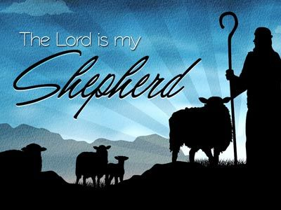
Can You Really Say:
Have you found rest in his provisions?
Have you received his forgiveness & guidance?
Have you found His comfort, peace & protection?
Have you accepted the many blessings God Provides?
Will you make the rest of your life – the best of your life?

Slide 14
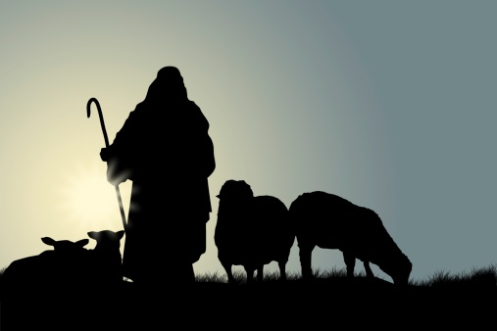
Spiritual Failure
Is The Result Of Following The
Wrong Shepherd

