Slide 2
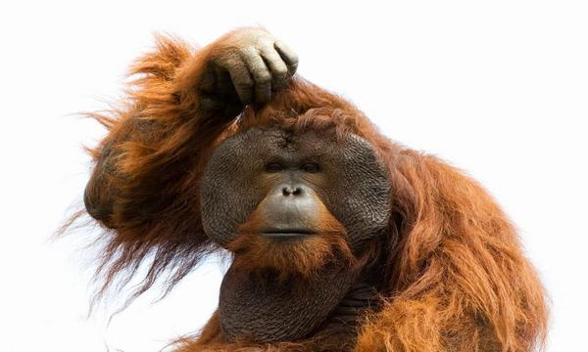
Things That
Don’t Make Sense

Slide 3
A High School Diploma represents an average investment of 15,120 hours
Along the way we learn much about things we do not believe we will ever need. We sometimes forget we are also learning how to learn and think.
A four-year college degree represents another 1,920 hours which amounts to a grand total of 17,040 hour

Slide 4
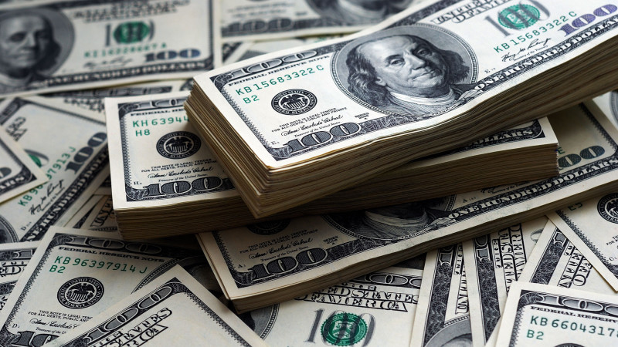
You Can Be Rich Without Money
It is possible to be rich and never have a large bank account or a fat wallet.
Revelation 2:9 – "'I know your tribulation and your poverty ( but you are rich) and the slander of those who say that they are Jews and are not, but are a synagogue of Satan.
2 Corinthians 6:1 – “As sorrowful, yet always rejoicing; as poor, yet making many rich; as having nothing, yet possessing everything.”

Slide 5
You Can Be Rich Without Money
Jesus gives us something money cannot buy: salvation from our sins and home reserved in heaven
2 Corinthians 8:9 – Jesus became poor so we could be rich with His grace
Ephesians 1:3 – Christ has blessed us with everything spiritual blessing.
1 Timothy 6:18 – We are to be rich in good works and generous and ready to share.

Slide 6
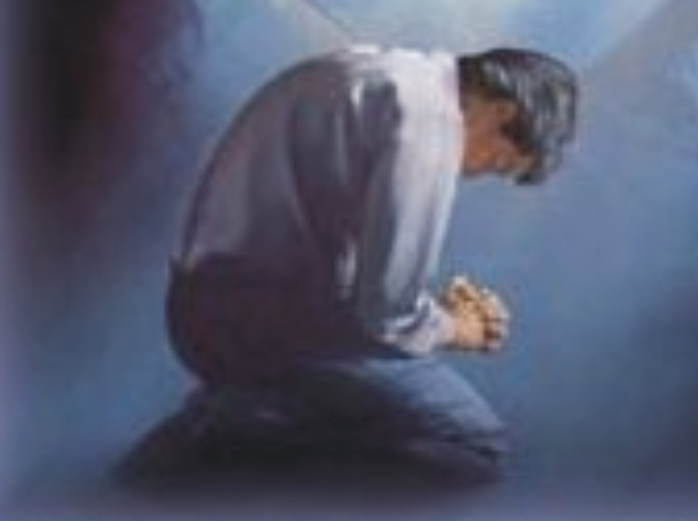
The Way Up Is Down
Watch out for pride; we have to get down on
our knees to ascend to heaven
Luke 18:11-14 – “The Pharisee, standing by himself, prayed thus: 'God, I thank you that I am not like other men, extortioners, unjust, adulterers, or even like this tax collector. I fast twice a week; I give tithes of all that I get.' But the tax collector, standing far off, would not even lift up his eyes to heaven, but beat his breast, saying, 'God, be merciful to me, a sinner!' I tell you, this man went down to his house justified, rather than the other. For everyone who exalts himself will be humbled, but the one who humbles himself will be exalted."
Matthew 5:3 – "Blessed are the poor in spirit, for theirs is the kingdom of heaven.”

Slide 7
One Is Strong When He Is Weak
Honorable and Biblical strength is different than worldly strength
2 Corinthians 12:9 – “But he said to me, ‘My grace is sufficient for you, for my power is made perfect in weakness.’ Therefore I will boast all the more gladly of my weaknesses, so that the power of Christ may rest upon me.’”
1 Corinthians 1:27 – “But God chose what is foolish in the world to shame the wise; God chose what is weak in the world to shame the strong.”

Slide 8
One Must Cry To Be Happy
Everyone wants to party and have a good time –
few want to contemplate seriously on life
Matthew 5:4 – "Blessed are those who mourn, for they shall be comforted.”
John 16:20 – “Truly, truly, I say to you, you will weep and lament, but the world will rejoice. You will be sorrowful, but your sorrow will turn into joy.”
Revelation 21:4 – “He will wipe away every tear from their eyes, and death shall be no more, neither shall there be mourning nor crying nor pain anymore, for the former things have passed away."

Slide 9
Things That
Don’t Make Sense
1 Corinthians 13:11-12:
“When I was a child, I spoke like a child, I thought like a child, I reasoned like a child. When I became a man, I gave up childish ways. For now we see in a mirror dimly, but then face to face. Now I know in part; then I shall know fully, even as I have been fully known.”

