Slide 2
Eastside Spring Meeting
Finding Answers
For Mental
Health & Addictions
Art Adams
April 5-8

Slide 3
Is Jesus Real?
Is the concept of Jesus the
greatest hoax in human history?
If Jesus was real, isn’t it more likely that he was just a good man that happened to be an extraordinarily gifted teacher?
2,000 years of human history separates us from Jesus, how can really know if he is real?

Slide 4
Without Using The Bible, Prove That Jesus Was The Son Of God
Without citing physics, prove to me that the speed of light can't be exceeded.
Without citing genetics, prove to me that all animals share some DNA.
Without citing meteorology, prove to me that weather is affected by high and low pressure areas.
Without citing oceanography, prove to me the relationship between weather and ocean currents.
Now, do you see how unreasonable the demands of this question are? If you can't use the basic tools of whatever discipline you pursue, you have no way to demonstrate the genuineness of a conclusion.
This question sets the bar of proof so high, that anything short of a personal visit from Jesus, hand-carrying a notarized copy of his birth certificate would not be good enough to authenticate Jesus’ claims.

Slide 5
Jesus In Prophecy
Prophecy Facts
Over 300 hundred OT prophecies regarding Jesus
No prophetic failures (100% accuracy).
Prophecies regarding Jesus were written hundreds (sometimes thousands of years) before Jesus was born.
Mathematicians have calculated the odds of Jesus fulfilling only 8 of the Messianic prophecies as 1 out of 10¹⁷ (a 1 followed by 17 zeros).

Slide 6
Jesus In Prophecy
A Few Examples
Messiah to be born in Bethlehem Micah 5:2 - Matthew 2:1-6
Messiah will perform miracles Isaiah 35:5-6 - Matthew 9:35; 11:3-6; John 9:6-7
Messiah will enter Jerusalem on a donkey Zechariah 9:9-10 - Matthew 21:1-11
Messiah to be betrayed by a friend Psalm 41:9 - John 13:18-21

Slide 7
Jesus In Prophecy
A Few Examples
Messiah to be raised from the dead Psalm 16:10 - Acts 2:25-31, 13:32-37, 17:2-3
Messiah to be at the right hand of God Psalm 110:1 -- Matthew 26:64; Mark 14:62; Romans 8:34; Hebrews 1:3
“For you will not abandon my soul to Sheol, or let your holy one see corruption.
- Psalm 16:10
“The Lord says to my Lord:
‘Sit at my right hand,
until I make your enemies your footstool.’"
- Psalm 110:1

Slide 8
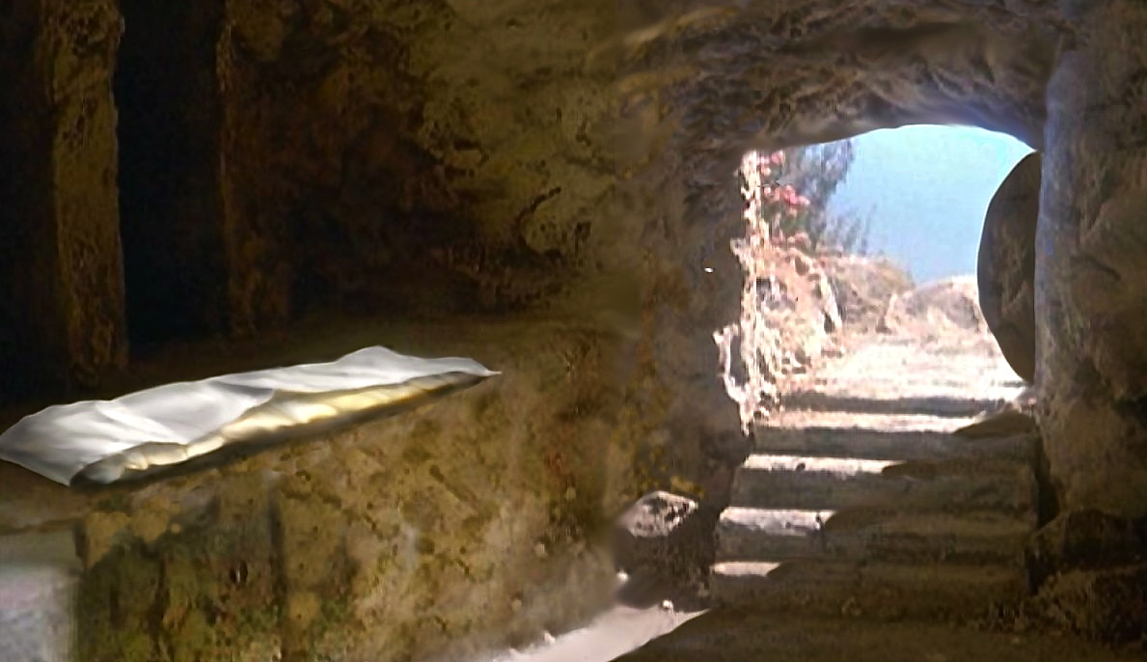
Eye Witness Testimony
Of His Resurrection
“For I delivered to you as of first importance what I also received: that Christ died for our sins in accordance with the Scriptures, that he was buried, that he was raised on the third day in accordance with the Scriptures, and that he appeared to Cephas, then to the twelve. Then he appeared to more than five hundred brothers at one time, most of whom are still alive, though some have fallen asleep. Then he appeared to James, then to all the apostles. Last of all, as to one untimely born, he appeared also to me.”
- 1 Corinthians 15:3-8

Slide 9
Eye Witness Testimony
Of His Resurrection
“Eight days later, his disciples were inside again, and Thomas was with them. Although the doors were locked, Jesus came and stood among them and said, ‘Peace be with you.’ Then he said to Thomas, ‘Put your finger here, and see my hands; and put out your hand, and place it in my side. Do not disbelieve, but believe.’ Thomas answered him, ‘My Lord and my God!’ Jesus said to him, ‘Have you believed because you have seen me? Blessed are those who have not seen and yet have believed.’”
- John 20:26-29

Slide 10
Eye Witness Testimony
Of His Resurrection
“And we are witnesses of all that he did both in the country of the Jews and in Jerusalem. They put him to death by hanging him on a tree, but God raised him on the third day and made him to appear, not to all the people but to us who had been chosen by God as witnesses, who ate and drank with him after he rose from the dead. And he commanded us to preach to the people and to testify that he is the one appointed by God to be judge of the living and the dead. To him all the prophets bear witness that everyone who believes in him receives forgiveness of sins through his name."
- Acts 10:39-43

Slide 11
The Claims Of Jesus
John 14:6-7 – “Jesus said to him, ‘I am the way, and the truth, and the life. No one comes to the Father except through me. If you had known me, you would have known my Father also. From now on you do know him and have seen him.’”
John 6:38 – “For I have come down from heaven, not to do my own will but the will of him who sent me.”
John 10:30 – “I and the Father are one."
John 8:58 – “Jesus said to them, ‘Truly, truly, I say to you, before Abraham was, I am.’”
Matthew 16:15-18 – “He said to them, ‘But who do you say that I am?’ Simon Peter replied, ‘You are the Christ, the Son of the living God.’ And Jesus answered him, ‘Blessed are you, Simon Bar-Jonah! For flesh and blood has not revealed this to you, but my Father who is in heaven. And I tell you, you are Peter, and on this rock I will build my church, and the gates of hell shall not prevail against it.’”

Slide 12
With Jesus,
It’s All Or Nothing!
So why does Jesus get special treatment? Why do we exalt him to the level of "good man" and "moral teacher" when anyone else who said what he said would be labeled insane or a con-man?
In His day, Jesus was given no special consideration. He was either accepted and worshiped, or rejected as a heretic.

Slide 13
With Jesus,
It’s All Or Nothing!
You must make your choice. Either this man was, and is, the Son of God: or else a madman or something worse. You can shut him up for a fool; you can spit at him and kill him for a demon; or you can fall at his feet and call him Lord and God. But let us not come with any patronizing nonsense about his being a great human teacher. He has not left that open to us. He did not intend to.

Slide 14
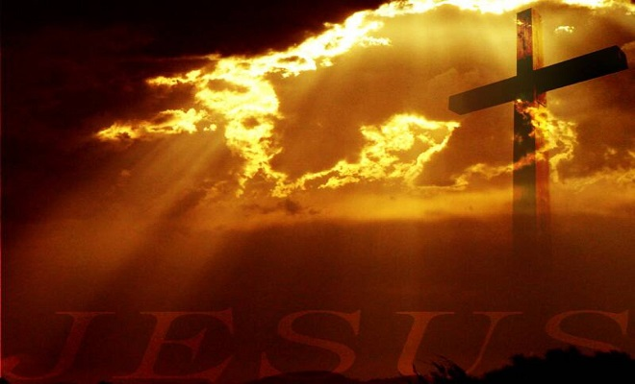
Who Is Jesus?
Colossians 1:15a – “And He is the image of the invisible God”
John 1:3 – “All things came into being by Him, and apart from Him nothing came into being that has come into being.”
Hebrews 1:3 – “…He upholds the universe by the word of his power.”
Ephesians 1:22-23 – “And He put all things in subjection under His feet, and gave Him as head over all things to the church, which is His body, the fullness of Him who fills all in all.”
Revelation 1:8 - “I am the Alpha and the Omega," says the Lord God, "who is and who was and who is to come, the Almighty."
Matthew 28:18b - “…All authority has been given to Me in heaven and on earth.”
1 Corinthians 15:25 - “For He must reign until He has put all His enemies under His feet.”

Slide 15
What Are You Going
To Do With Jesus?
IGNORE
HIM?
DEAL With Him Later?
REJECT
HIM?
Hope He Goes Away?

Slide 16
What Are You Going
To Do With Jesus?
John 8:24 - "I said therefore to you, that you shall die in your sins; for unless you believe that I am He, you shall die in your sins."
Hebrews 11:6 – “And without faith it is impossible to please him, for whoever would draw near to God must believe that he exists and that he rewards those who seek him.”
Acts 4:12 – “And there is salvation in no one else, for there is no other name under heaven given among men by which we must be saved."
Mark 16:16 – “Whoever believes and is baptized will be saved, but whoever does not believe will be condemned.”

