Slide 1
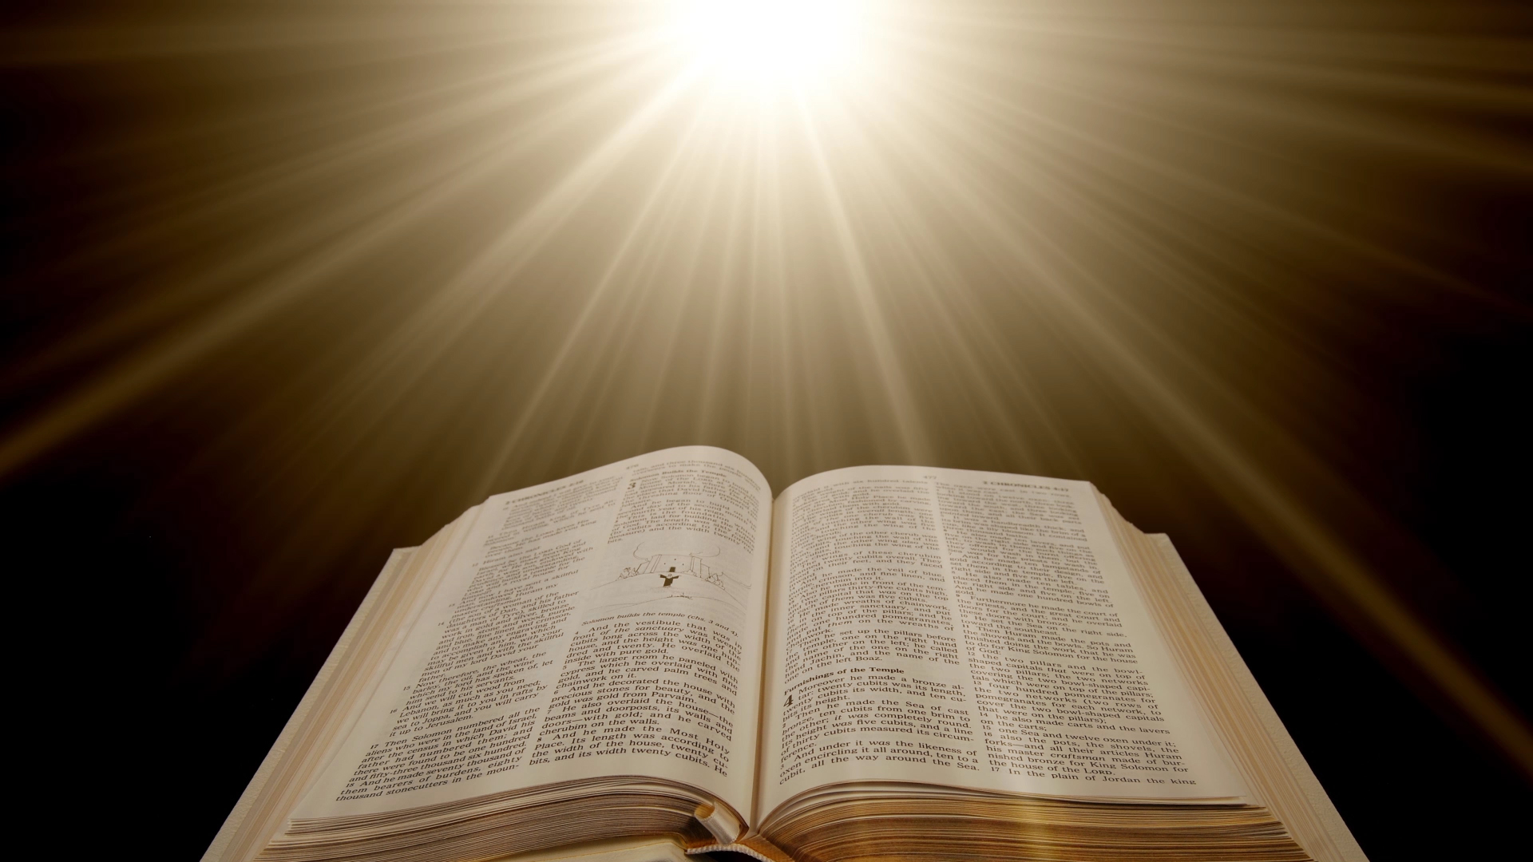
Two Plans – Two Outcomes
God’s Plan of Redemption vs. Satan’s Plan of Condemnation
2 Timothy 3:10-17

Slide 2
Two Plans – Two Outcomes
You followed my:
Teaching
Conduct
Aim in life
Faith
Patience
Love
Steadfastness
Persecutions
Sufferings
All Scripture Is Profitable For:
Teaching
Reproof
Correction
Training in righteousness
2 Timothy 3:10-17
“You, however, have followed my teaching, my conduct, my aim in life, my faith, my patience, my love, my steadfastness, my persecutions and sufferings that happened to me at Antioch, at Iconium, and at Lystra—which persecutions I endured; yet from them all the Lord rescued me. Indeed, all who desire to live a godly life in Christ Jesus will be persecuted, while evil people and impostors will go on from bad to worse, deceiving and being deceived. But as for you, continue in what you have learned and have firmly believed, knowing from whom you learned it and how from childhood you have been acquainted with the sacred writings, which are able to make you wise for salvation through faith in Christ Jesus. All Scripture is breathed out by God and profitable for teaching, for reproof, for correction, and for training in righteousness, that the man of God may be competent, equipped for every good work.”

Slide 3
Two Plans – Two Outcomes
Current social reasoning claims that the Bible system of morality is invalid, archaic, filled with weakness, has slowed the progress of mankind, and has filled us with puritanical hang-ups.
Blurring the lines, and replacing black and white with gray is how the devil slowly draws us into his plan of condemnation.

Slide 4
Two Plans – Two Outcomes
1 Peter 4:3-5
“The time that is past suffices for doing what the Gentiles want to do, living in sensuality, passions, drunkenness, orgies, drinking parties, and lawless idolatry. With respect to this they are surprised when you do not join them in the same flood of debauchery, and they malign you; but they will give account to him who is ready to judge the living and the dead.”

Slide 5
Two Plans – Two Outcomes
Let’s look at some of the ways Satan’s plan tries to validate itself.

Slide 6
“Everyone Is Doing It”
Standard is the will of the majority.
Majority determines right and wrong
Matthew 7:13-14
"Enter by the narrow gate. For the gate is wide and the way is easy that leads to destruction, and those who enter by it are many. For the gate is narrow and the way is hard that leads to life, and those who find it are few.”
2 Corinthians 4:4
“In their case the god of this world has blinded the minds of the unbelievers, to keep them from seeing the light of the gospel of the glory of Christ, who is the image of God.”

Slide 7
“As Long As No One Gets Hurt”
The Results Are All That Is Important
Consensual = Moral?
Leviticus 10:1-3
“Now Nadab and Abihu, the sons of Aaron, each took his censer and put fire in it and laid incense on it and offered unauthorized fire before the Lord, which he had not commanded them. And fire came out from before the Lord and consumed them, and they died before the Lord. Then Moses said to Aaron, ‘This is what the Lord has said, 'Among those who are near me I will be sanctified, and before all the people I will be glorified.'" And Aaron held his peace.”
2 Timothy 1:13
Follow the pattern of the sound words that you have heard from me, in the faith and love that are in Christ Jesus.”

Slide 8
“It’s My Life, I’ll Do What I Want”
The Standard Is Self-Interest - “I Am The Standard”
Jeremiah 10:23
“I know, O Lord, that the way of man is not in himself,
that it is not in man who walks to direct his steps.”
Proverbs 3:5-7
“Trust in the Lord with all your heart, and do not lean on your own understanding. In all your ways acknowledge him, and he will make straight your paths. Be not wise in your own eyes; fear the Lord, and turn away from evil.

Slide 9
“Times Are Changing”
The “Get-With-It” Plan
A Flexible Morality
2 Timothy 4:3-5
“For the time is coming when people will not endure sound teaching, but having itching ears they will accumulate for themselves teachers to suit their own passions, and will turn away from listening to the truth and wander off into myths. As for you, always be sober-minded, endure suffering, do the work of an evangelist, fulfill your ministry.”

Slide 10
“I Only Did It Once”
“As long as it isn’t repetitious, it’s okay”
Many people want to define morality by the demands of the moment
2 Samuel 6:6-7
“And when they came to the threshing floor of Nacon, Uzzah put out his hand to the ark of God and took hold of it, for the oxen stumbled. And the anger of the Lord was kindled against Uzzah, and God struck him down there because of his error, and he died there beside the ark of God.
Matthew 12:30
“Whoever is not with me is against me, and whoever does not gather with me scatters.”

Slide 11
“I’m A Victim”
“There were circumstances beyond my control – I couldn’t help it.”
Aaron (Exodus 32:21-24)
King Saul (1 Samuel 13:8-12) – “I forced myself.”
1 Corinthians 10:13
“No temptation has overtaken you that is not common to man. God is faithful, and he will not let you be tempted beyond your ability, but with the temptation he will also provide the way of escape, that you may be able to endure it.”

Slide 12
“I Was Told It Was Ok”
“I am too weak, ignorant, confused, inexperienced to discern right from Wrong.”
2 John 9
“Everyone who goes on ahead and does not abide in the teaching of Christ, does not have God. Whoever abides in the teaching has both the Father and the Son.”
Ephesians 3:4
“When you read this, you can perceive my insight into the mystery of Christ.”

Slide 13
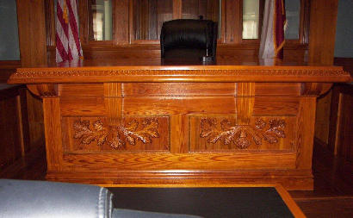
If you received a citation for doing 80 mph on 25th Street, and you decided to appear before the judge. How would he react if you said:
“Everyone is doing it, why are you picking on me?”
“I didn’t hurt anyone judge; nothing happened.”
“It’s my life, who are you to tell me to go 40 MPH?”
“Come on Judge you old fogy, times are changing. I drive a high-performance sports car and you expect me to poke along at 40?”
“It didn’t bother me, why should it bother you?”
“Just had to try 80 MPH once to see what it was like.”
“My driving instructor said it would be ok.”

Slide 14
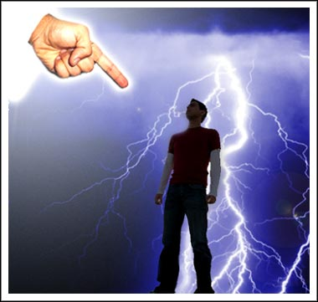
2 Corinthians 5:10
“For we must all appear before the judgment seat of Christ, so that each one may receive what is due for what he has done in the body, whether good or evil.”
Which Will It Be?
God’s Plan of Redemption, or Satan’s Plan of Condemnation?
Acts 2:38 -- Mark 16:16 – John 14:15

