Slide 1
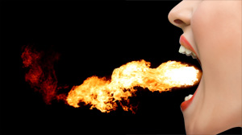
SINS OF THE TONGUE (Pt. 1)
James 3:5-6
“So also the tongue is a small part of the body, and yet it boasts of great things. Behold, how great a forest is set aflame by such a small fire! And the tongue is a fire, the very world of iniquity; the tongue is set among our members as that which defiles the entire body, and sets on fire the course of our life, and is set on fire by hell.”
“I said, I will guard my ways, That I may not sin with my tongue; I will guard my mouth as with a muzzle, While the wicked are in my presence."
- Psalm 39:1

Slide 2
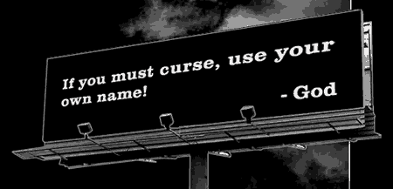
Disrespectful Use
Of God’s Name
Exodus 20:7
You shall not take the name of the Lord your God in vain, for the Lord will not hold him guiltless who takes his name in vain.
Psalm 8:1
O Lord, our Lord, How majestic is Thy name in all the earth, Who hast displayed Thy splendor above the heavens!
Psalm 111:9
He has sent redemption to His people; He has ordained His covenant forever; Holy and awesome is His name.
VAIN:
Emptiness, Nothingness
Misuse

Slide 3
Disrespectful Use
Of Jesus’ Name
Those who name the name of Christ, who pray in His name, and who take His name as part of their identity, but who deliberately and continually disobey His commands, are taking His name in vain.
Philippians 2:9-11
Therefore also God highly exalted Him, and bestowed on Him the name which is above every name, that at the name of Jesus every knee should bow, of those who are in heaven, and on earth, and under the earth, and that every tongue should confess that Jesus Christ is Lord, to the glory of God the Father.
Luke 6:46
And why do you call Me, 'Lord, Lord,' and do not do what I say?

Slide 4
Obscene Talk
(Shameful)
Colossians 3:8
But now you must put them all away: anger, wrath, malice, slander, and obscene talk from your mouth.
Matthew 12:34
You brood of vipers, how can you, being evil, speak what is good? For the mouth speaks out of that which fills the heart.
Philippians 4:8
Finally, brethren, whatever is true, whatever is honorable, whatever is right, whatever is pure, whatever is lovely, whatever is of good repute, if there is any excellence and if anything worthy of praise, let your mind dwell on these things.

Slide 5
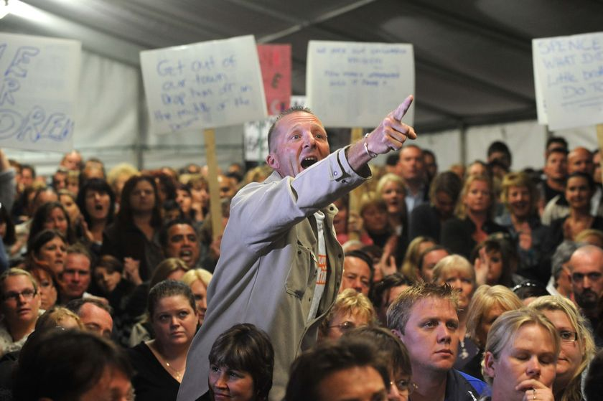
Clamor
(Outcry)
Ephesians 4:31-32
Let all bitterness and wrath and anger and clamor and slander be put away from you, along with all malice. And be kind to one another, tender-hearted, forgiving each other, just as God in Christ also has forgiven you.
“Noise, disorder, high words; such as men in a brawl, or when they are excited.”
Barnes Commentary
Christians are to be calm and controlled!

Slide 6
Hasty Words
James 1:19-20
This you know, my beloved brethren. But let everyone be quick to hear, slow to speak and slow to anger; for the anger of man does not achieve the righteousness of God.
Proverbs 21:23
He who guards his mouth and his tongue, Guards his soul from troubles.
Think Twice Before You Speak!

Slide 7
Angry Words That Promote Strife
Proverbs 15:1
A gentle answer turns away wrath, But a harsh word stirs up anger.
Proverbs 29:11
A fool always loses his temper, But a wise man holds it back.
A Christian Should NEVER brag about having a temper!
Titus 3:2 (ESV)
To speak evil of no one, to avoid quarreling, to be gentle, and to show perfect courtesy toward all people.

Slide 8
Deceitful Speaking
Jeremiah 9:8
Their tongue is a deadly arrow; It speaks deceit; With his mouth one speaks peace to his neighbor, But inwardly he sets an ambush for him.
Examples:
Speaking words of faith followed later by words of doubt.
Behaving one way when with Christians, and another with co-workers and worldly friends.
Using deceit and misrepresentation to achieve some form of gain.
1 Timothy 3:8
Deacons likewise must be men of dignity, not double-tongued, or addicted to much wine or fond of sordid gain.

Slide 9
SINS OF THE TONGUE
1 Peter 3:8-12
To sum up, let all be harmonious, sympathetic, brotherly, kindhearted, and humble in spirit; not returning evil for evil, or insult for insult, but giving a blessing instead; for you were called for the very purpose that you might inherit a blessing. For, Let him who means to love life and see good days
Refrain his tongue from evil and his lips from speaking guile.
And let him turn away from evil and do good; Let him seek peace and pursue it. For the eyes of the Lord are upon the righteous, And His ears attend to their prayer, But the face of the Lord is against those who do evil."

