Slide 1
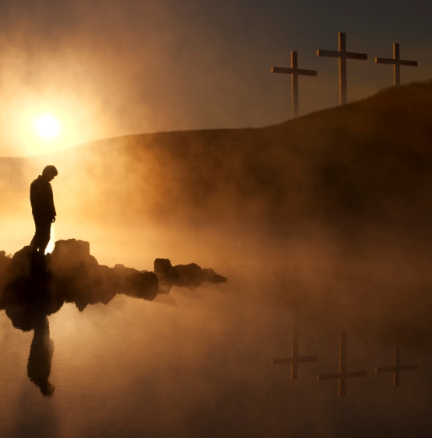
Three Crucifixions Of The New Testament

Slide 2
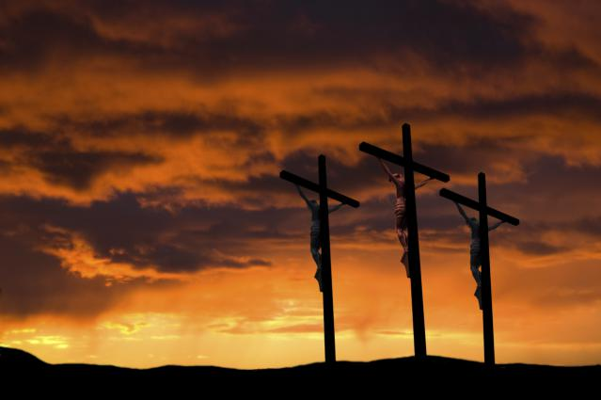
The Crucifixion Of Christ
What we see in
Christ’s crucifixion:
The wickedness of sinful man
The suffering of the sinless Son of God
The Love of God for sinners
Sinner’s only hope -- JESUS

Slide 3
The Crucifixion Of Christ
Sins Involved In
Christ’s Crucifixion
Envy & Hatred
Love of money
Lying
Apathy
Neglect
Cruelty
Manipulation

Slide 4
The Crucifixion Of Christ
What Was Done:
Matthew 27:15-21 – Jews refused Pilate’s offer to release Jesus and demanded the release of Barabbas – a murderer.
Matthew 27:22-23 - When Pilate asked the Jews what should be done with Jesus, they shouted and demanded his crucifixion.
Matthew 27:28 – Stripped of his clothes
Matthew 27:26 – Scourged
Matthew 27:29 – Crown of thorns
Matthew 27:29-31 – Mocked, spat upon, beaten.

Slide 5
The Crucifixion Of Christ
The Purpose:
Hebrews 2:9 – Jesus tasted death for everyone
Acts 2:36 – God made Jesus both Lord and Christ
Acts 4:12 – Salvation can only be found in the name of Jesus.
1 Peter 3:18 – “For Christ also suffered once for sins, the righteous for the unrighteous, that he might bring us to God, being put to death in the flesh but made alive in the spirit.”

Slide 6
The Crucifixion
Of The World

Slide 7
The Crucifixion
Of The World
Produced By A Realization Of True Values
Matthew 16:26 – “For what will it profit a man if he gains the whole world and forfeits his life? Or what shall a man give in return for his life?”
Philippians 3:7 – “But whatever gain I had, I counted as loss for the sake of Christ.”
1 John 2:15 – “Do not love the world or the things in the world. If anyone loves the world, the love of the Father is not in him.”

Slide 8
The Crucifixion
Of The World
Jesus delivered us from the world
Galatians 1:3-4 – “Grace to you and peace from God our Father and the Lord Jesus Christ, who gave himself for our sins to deliver us from the present evil age, according to the will of our God and Father.”

Slide 9
The Crucifixion
Of The World
It’s up to us to judge ourselves to see it this is so
1 Corinthians 11:31-32 – “But if we judged ourselves truly, we would not be judged. But when we are judged by the Lord, we are disciplined so that we may not be condemned along with the world.”
1 Corinthians 11:28 – “Let a person examine himself, then, and so eat of the bread and drink of the cup.”
2 Corinthians 13:5 - “Examine yourselves, to see whether you are in the faith. Test yourselves. Or do you not realize this about yourselves, that Jesus Christ is in you?—unless indeed you fail to meet the test!”

Slide 10
The Crucifixion Of Self
Romans 6:6-8 – “We know that our old self was crucified with him in order that the body of sin might be brought to nothing, so that we would no longer be enslaved to sin. For one who has died has been set free from sin. Now if we have died with Christ, we believe that we will also live with him.”
Galatians 5:24 – “And those who belong to Christ Jesus have crucified the flesh with its passions and desires.”
Colossians 3:5 – “Put to death therefore what is earthly in you: sexual immorality, impurity, passion, evil desire, and covetousness, which is idolatry.”

Slide 11
Three Crucifixions Of
The New Testament
Christ • World • Self
“I have been crucified with Christ. It is no longer I who live, but Christ who lives in me. And the life I now live in the flesh I live by faith in the Son of God, who loved me and gave himself for me.”
- Galatians 2:20

