Slide 2
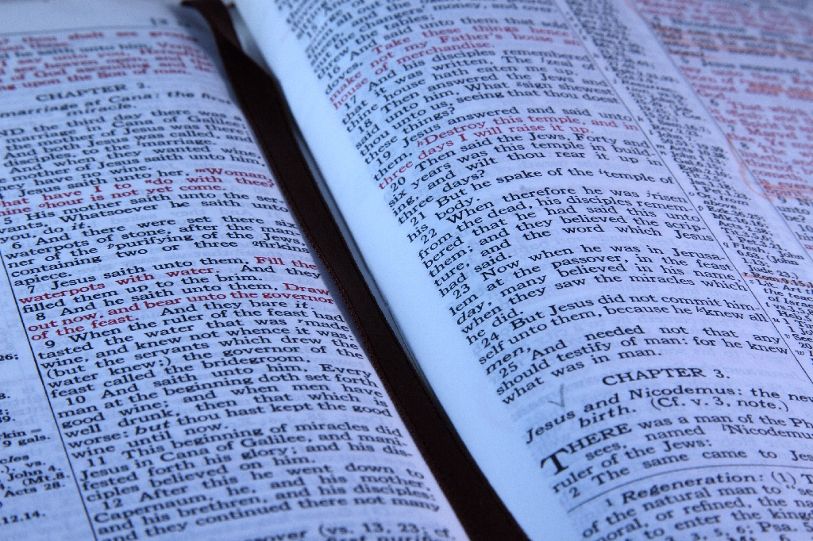
Getting Hired: Faith & Obedience
“Whoever believes and is baptized will be saved, but whoever does not believe will be condemned.”
- Mark 16:16

Slide 3
Getting Hired: Faith & Obedience
“And Peter said to them, "Repent and be baptized every one of you in the name of Jesus Christ for the forgiveness of your sins, and you will receive the gift of the Holy Spirit.”
- Acts 2:38

Slide 4
TITLE: Children of God
“See how great a love the Father has bestowed upon us, that we should be called children of God; and such we are. For this reason the world does not know us, because it did not know Him.”
- 1 John 3:1

Slide 5
TITLE: Children of God
“For you are all sons of God through faith in Christ Jesus. For all of you who were baptized into Christ have clothed yourselves with Christ.”
- Galatians 3:26-27

Slide 6
TITLE: Children of God
By this the children of God and the children of the devil are obvious: anyone who does not practice righteousness is not of God, nor the one who does not love his brother.
- 1 John 3:10

Slide 7
ATTITUDE: Joy For The Opportunity
“And when they came up out of the water, the Spirit of the Lord snatched Philip away; and the eunuch saw him no more, but went on his way rejoicing.”
- Acts 8:39

Slide 8
ATTITUDE: Joy For The Opportunity
“There is therefore now no condemnation for those who are in Christ Jesus.” - Romans 8:1

Slide 9
ATTITUDE: Joy For The Opportunity
“And though you have not seen Him, you love Him, and though you do not see Him now, but believe in Him, you greatly rejoice with joy inexpressible and full of glory, obtaining as the outcome of your faith the salvation of your souls.”
- 1 Peter 1:8-9

Slide 10
ASSOCIATES: Fellowship With Christ & Fellow Christians
“But if we walk in the light as He Himself is in the light, we have fellowship with one another, and the blood of Jesus His Son cleanses us from all sin.”
- 1 John 1:7

Slide 11
ASSOCIATES: Fellowship With Christ & Fellow Christians
Do not be deceived: "Bad company corrupts good morals.“
- 1 Corinthians 15:33

Slide 12
THE BOSS: God & Christ
“But I want you to understand that the head of every man is Christ, the head of a wife is her husband, and the head of Christ is God.”
- 1 Corinthians 11:3-4

Slide 13
THE BOSS: God & Christ
“So that at the name of Jesus every knee should bow, in heaven and on earth and under the earth, and every tongue confess that Jesus Christ is Lord, to the glory of God the Father.”
- Philippians 2:10-11

Slide 14
FOCUS: Overcome Self & The World
“Set your minds on things that are above, not on things that are on earth. For you have died, and your life is hidden with Christ in God.”
- Colossians 3:2-3

Slide 15
FOCUS: Overcome Self & The World
“He who overcomes shall thus be clothed in white garments; and I will not erase his name from the book of life, and I will confess his name before My Father, and before His angels.”
- Revelation 3:5

Slide 16
FOCUS: Overcome Self & The World
“Do not love the world or the things in the world. If anyone loves the world, the love of the Father is not in him. For all that is in the world— the desires of the flesh and the desires of the eyes and pride in possessions—is not from the Father but is from the world. And the world is passing away along with its desires, but whoever does the will of God abides forever.”
- 1 John 2:15-17

Slide 17
ADVERTISING: Winning Souls For Jesus
The fruit of the righteous is a tree of life, And he who is wise wins souls.
- Proverbs 11:30

Slide 18
ADVERTISING: Winning Souls For Jesus
“In the same way, you wives, be submissive to your own husbands so that even if any of them are disobedient to the word, they may be won without a word by the behavior of their wives, as they observe your chaste and respectful behavior.
- 1 Peter 3:1-2

Slide 19
ADVERTISING: Winning Souls For Jesus
“Go therefore and make disciples of all nations, baptizing them in the name of the Father and of the Son and of the Holy Spirit, teaching them to observe all that I have commanded you. And behold, I am with you always, to the end of the age."
- Matthew 28:19-20

Slide 20
DON’T GET FIRED: By Displeasing God And Losing Your Soul
“For what will a man be profited, if he gains the whole world, and forfeits his soul? Or what will a man give in exchange for his soul?”
- Matthew 16:26

Slide 21
DON’T GET FIRED: By Displeasing God And Losing Your Soul
“But we are not of those who shrink back to destruction, but of those who have faith to the preserving of the soul.”
- Hebrews 10:39

Slide 22
DON’T GET FIRED: By Displeasing God And Losing Your Soul
“But the one who endures to the end will be saved.”
- Matthew 24:13

Slide 23
An Eternity of Blessings And Benefits.
Eternal
Retirement:
“Keep yourselves in the love of God, waiting anxiously for the mercy of our Lord Jesus Christ to eternal life.”
- Jude 21

