Slide 1
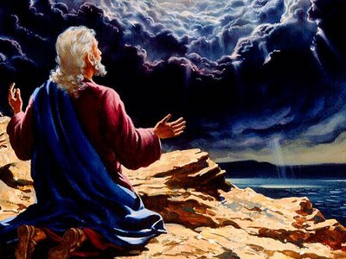
John’s Pictures
Of Jesus
Revelation 1:9-20

Slide 2
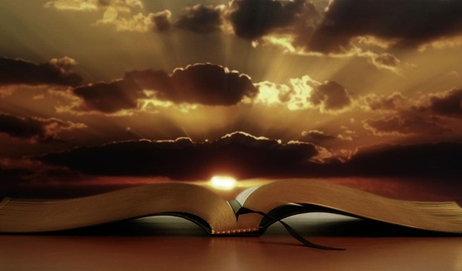
A Picture Is Worth A Thousand Words
"A picture is worth a thousand words" is an English idiom. It refers to the notion that a complex idea can be conveyed with just a single still image or that an image of a subject conveys its meaning or essence more effectively than a description does. (Frank Bernard – 1927)
”Hearing something a hundred times isn’t better than seeing it once” Confucius – Chinese philosopher (551-479 BC)
When we read our mind creates mental pictures or images.
The book of revelation is written to appeal to our senses – it provides us with a mental image of Jesus and his kingdom – being victorious over Satan and his kingdom.
John’s Pictures Of Jesus
Revelation 1:9-20

Slide 3
What John Heard: The Voice Of The Lord
Revelation 1:9-11: “I, John, your brother and partner in the tribulation and the kingdom and the patient endurance that are in Jesus, was on the island called Patmos on account of the word of God and the testimony of Jesus. I was in the Spirit on the Lord's day, and I heard behind me a loud voice like a trumpet saying, "Write what you see in a book and send it to the seven churches, to Ephesus and to Smyrna and to Pergamum and to Thyatira and to Sardis and to Philadelphia and to Laodicea."
John’s Pictures Of Jesus
Revelation 1:9-20

Slide 4
What John Heard: The Voice Of The Lord
John Is A Partner Of:
TRIBULATION – Exiled on the island of Patmos.
PERSEVERENCE – Acts 12:1-5: His brother James was killed by Herod; Acts 4-5 – was arrested multiple times.
THE KINGDOM - Matthew 4:21-22: “And going on from there he saw two other brothers, James the son of Zebedee and John his brother, in the boat with Zebedee their father, mending their nets, and he called them. Immediately they left the boat and their father and followed him.”
John’s Pictures Of Jesus
Revelation 1:9-20

Slide 5
What John Heard: The Voice Of The Lord
Close To Jesus:
With Peter at the transfiguration (Matthew 17:1-9)
On the cross Jesus asked him to care for his mother (John 19:26-27)
John was probably referring to himself when he refers to the one Jesus loved (John 13:23)
John’s Pictures Of Jesus
Revelation 1:9-20

Slide 6
What John Heard: The Voice Of The Lord
“Write What You See And Send It To The Seven Churches”:
Revelation 14:13: “And I heard a voice from heaven saying, ‘Write this: Blessed are the dead who die in the Lord from now on. Blessed indeed,’ says the Spirit, ‘that they may rest from their labors, for their deeds follow them!’"
Revelation 19:9: “And the angel said to me, “Write this: Blessed are those who are invited to the marriage supper of the Lamb.’ And he said to me, ‘These are the true words of God.’"
Revelation 21:5: “And he who was seated on the throne said, ‘Behold, I am making all things new.’ Also he said, ‘Write this down, for these words are trustworthy and true.’"
John’s Pictures Of Jesus
Revelation 1:9-20

Slide 7
What John Heard: The Voice Of The Lord
Do You Obey The Voice Of The Lord?
John 14:15: "If you love me, you will keep my commandments.”
John’s Pictures Of Jesus
Revelation 1:9-20

Slide 8
What John SAW: Jesus In The Middle Of His People
Revelation 1:12-16: “Then I turned to see the voice that was speaking to me, and on turning I saw seven golden lampstands, and in the midst of the lampstands one like a son of man, clothed with a long robe and with a golden sash around his chest. The hairs of his head were white like wool, as white as snow. His eyes were like a flame of fire, his feet were like burnished bronze, refined in a furnace, and his voice was like the roar of many waters. In his right hand he held seven stars, from his mouth came a sharp two-edged sword, and his face was like the sun shining in full strength.”
John’s Pictures Of Jesus
Revelation 1:9-20

Slide 9
What John SAW: Jesus In The Middle Of His People
How Does John See Jesus In His Vision?
“Clothed with a long robe and with a golden sash around his chest.” – Majestic, kingly apparel
“The hairs of his head were white like wool, as white as snow.” In the Bible white has always been a symbol of purity and holiness.
“His eyes were like a flame of fire” - Fire has always been the great purifier. His vision is piercing and penetrating.
“His feet were like burnished bronze, refined in a furnace” – Tamp down all evil and opposition.
“And his voice was like the roar of many waters” - His voice and message is overpowering.
“From his mouth came a sharp two-edged sword, and his face was like the sun shining in full strength.” Jesus appears in glory, spender and power.
John’s Pictures Of Jesus
Revelation 1:9-20

Slide 10
What John SAW: Jesus In The Middle Of His People
Jesus Is Always In The Middle Of His People:
2 Corinthians 13:5: . “…Or do you not realize this about yourselves, that Jesus Christ is in you?...”
Ephesians 3:17: “So that Christ may dwell in your hearts through faith—that you, being rooted and grounded in love.”
John’s Pictures Of Jesus
Revelation 1:9-20

Slide 11
What John FELT: The Desire To
Worship And Be Comforted By Jesus
Revelation 1:17: “When I saw him, I fell at his feet as though dead. But he laid his right hand on me, saying, ‘Fear not, I am the first and the last,’”
Daniel 10:9-11: “Then I heard the sound of his words, and as I heard the sound of his words, I fell on my face in deep sleep with my face to the ground. And behold, a hand touched me and set me trembling on my hands and knees. And he said to me, ‘O Daniel, man greatly loved, understand the words that I speak to you, and stand upright, for now I have been sent to you.’ And when he had spoken this word to me, I stood up trembling.
John’s Pictures Of Jesus
Revelation 1:9-20

Slide 12
What John FELT: The Desire To
Worship And Be Comforted By Jesus
Isaiah 41:10: “Fear not, for I am with you; be not dismayed, for I am your God; I will strengthen you, I will help you, I will uphold you with my righteous right hand.
John’s Pictures Of Jesus
Revelation 1:9-20

Slide 13
What Jesus SAID: Don’t Fear Life Or Death
Revelation 1:18-20: “And the living one. I died, and behold I am alive forevermore, and I have the keys of Death and Hades. Write therefore the things that you have seen, those that are and those that are to take place after this. As for the mystery of the seven stars that you saw in my right hand, and the seven golden lampstands, the seven stars are the angels of the seven churches, and the seven lampstands are the seven churches.
Matthew 16:18: "And I also say to you that you are Peter, and upon this rock I will build My church; and the gates of Hades shall not overpower it.”
1 Corinthians 15:55: "O death, where is your victory? O death, where is your sting?"
John’s Pictures Of Jesus
Revelation 1:9-20

Slide 14
John’s Pictures
Of Jesus
Revelation 1:9-20

