Slide 2
We Value Our
COMFORT

Slide 3
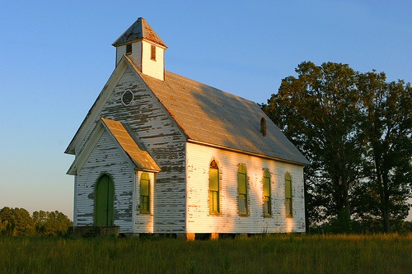
Comfort Or Persecution?
Many look for comfortable Christianity where everything is peace, love, and acceptance. Where few demands must be met, and everything is positive and happy.
2 Timothy 3:12-14
“Indeed, all who desire to live a godly life in Christ Jesus will be persecuted, while evil people and impostors will go on from bad to worse, deceiving and being deceived. But as for you, continue in what you have learned and have firmly believed, knowing from whom you learned it.”

Slide 4
Following Jesus Is Often An Uphill Issue
Following Jesus Will Always Cost You Something. There is no such thing as a “No-Cost” Salvation!
Hardships & Sacrifice
Luke 9:57-58
“As they were going along the road, someone said to him, ‘I will follow you wherever you go.’ And Jesus said to him, "Foxes have holes, and birds of the air have nests, but the Son of Man has nowhere to lay his head.’”
Romans 12:1
“I appeal to you therefore, brothers, by the mercies of God, to present your bodies as a living sacrifice, holy and acceptable to God, which is your spiritual worship.”
Luke 9:57-62

Slide 5
Following Jesus Is Often An Uphill Issue
When you have time conflicts in your life, who comes out on top? Jesus, or someone or something else?
Making Difficult Choices
Luke 9:59-60
“To another he said, ‘Follow me.’ But he said, ‘Lord, let me first go and bury my father.’ And Jesus said to him, ‘Leave the dead to bury their own dead. But as for you, go and proclaim the kingdom of God.’”
Matthew 22:37-38
And he said to him, "You shall love the Lord your God with all your heart and with all your soul and with all your mind. This is the great and first commandment.”
Luke 9:57-62

Slide 6
What does Jesus want from his followers? Total dedication, not halfhearted commitment.
Following Jesus Is Often An Uphill Issue
Looking Forward – Not Backward
Luke 9:61-62
“Yet another said, ‘I will follow you, Lord, but let me first say farewell to those at my home.’ Jesus said to him, ‘No one who puts his hand to the plow and looks back is fit for the kingdom of God.’”
Luke 10:2
“And he said to them, ‘The harvest is plentiful, but the laborers are few. Therefore pray earnestly to the Lord of the harvest to send out laborers into his harvest.’”
1 Kings 19:19-21
Elisha was called to be a prophet right in the middle of plowing a field — and he never looked back. In fact, he slaughtered the oxen so that they would not even be a temptation to return.
Luke 9:57-62

Slide 7
Luke 14:25-26
“Now great crowds accompanied him, and he turned and said to them, ‘If anyone comes to me and does not hate his own father and mother and wife and children and brothers and sisters, yes, and even his own life, he cannot be my disciple.’”
Christ’s underlying question is, “How far are you willing to go?”
John 12:25-26
“Whoever loves his life loses it, and whoever hates his life in this world will keep it for eternal life. If anyone serves me, he must follow me; and where I am, there will my servant be also. If anyone serves me, the Father will honor him.”

Slide 8
Following Christ means total submission to him — perhaps even to the point of death.
Luke 14:27
“Whoever does not bear his own cross and come after me cannot be my disciple.”
1 Peter 2:21
“For to this you have been called, because Christ also suffered for you, leaving you an example, so that you might follow in his steps.”

Slide 9
Luke 14:28-33
Examples of counting the cost:
Building a tower
King going to battle
If necessary, must be willing to give up everything
There is a cost in following Jesus. It is not a joyride, nor is it a passage to health and wealth!
Acts 21:13-14
“Then Paul answered, ‘What are you doing, weeping and breaking my heart? For I am ready not only to be imprisoned but even to die in Jerusalem for the name of the Lord Jesus.’ And since he would not be persuaded, we ceased and said, "Let the will of the Lord be done.’”

Slide 10
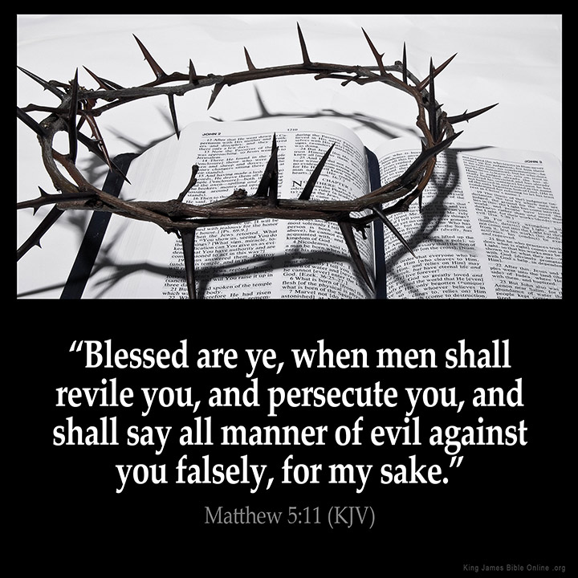
"Blessed are you when others revile you and persecute you and utter all kinds of evil against you falsely on my account. Rejoice and be glad, for your reward is great in heaven, for so they persecuted the prophets who were before you.”
Matthew 5:11-12 (ESV)

Slide 11
1 Peter 2:23- “When he was reviled, he did not revile in return; when he suffered, he did not threaten, but continued entrusting himself to him who judges justly.
1 Peter 4:14 – “If you are insulted for the name of Christ, you are blessed, because the Spirit of glory and of God rests upon you.”

Slide 12
Comfort Or Persecution?
Would persecutions and insults scare you away?

